Slide 1
GOOGLE PLAY STORE DATA ANALYSIS

Slide 2
Table of Contents:
Introduction
Objectives
Methodology
Data Collection
Data Cleaning and Transformation
Data Analysis and Insights
Visualization and Reporting
Results and Findings
Recommendations
Conclusion

Slide 3
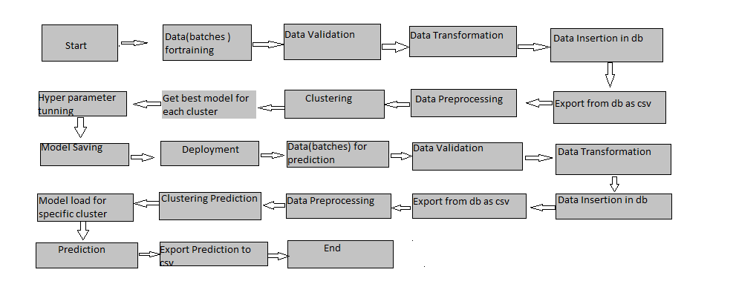
Architecture

Slide 4
Introduction:
The purpose of this project is to analyze data from the Google Play Store and derive valuable insights to enhance app performance, user experience, and business growth. The project utilizes data analysis techniques, visualization tools, and reporting capabilities to explore various metrics such as installs, ratings, reviews, and revenue. By analyzing this data, we aim to gain a comprehensive understanding of app trends, user behavior, and potential areas for improvement.
Objectives:
Analyze app performance metrics, including installs, ratings, and reviews.
Identify popular app categories and user preferences.
Understand the relationship between app size, price, and user engagement.
Evaluate the impact of app updates on user ratings and reviews.
Assess the correlation between app ratings, reviews, and revenue.
Provide actionable recommendations to optimize app performance and user satisfaction.

Slide 5
Methodology:
The project follows a systematic approach to analyze Google Play Store data. It involves data collection, cleaning, transformation, analysis, visualization, and reporting. The analysis is performed using statistical techniques, exploratory data analysis, and data visualization tools.
Data Collection:
Data is collected from the Google Play Store using the Google Play Developer API. The API provides access to various app-related data points, including app details, ratings, reviews, and revenue. The data collection process ensures the retrieval of a diverse set of apps from different categories, sizes, and pricing models.

Slide 6
Data Cleaning and Transformation:
The collected data undergoes a comprehensive cleaning and transformation process. This involves removing duplicate records, handling missing values, standardizing data formats, and performing necessary data transformations. The transformed data is structured and prepared for analysis.
Data Analysis and Insights:
The transformed data is subjected to various analysis techniques to derive meaningful insights. Key analysis areas include app popularity, user ratings, user behavior, revenue generation, and app update impact. Statistical analysis, trend analysis, and correlation analysis are performed to uncover patterns and relationships within the data.

Slide 7
Visualization and Reporting:
Visualizations and interactive reports are created using visualization tools such as Power BI. The reports present the analyzed data in a visually appealing and intuitive manner. Various charts, graphs, and tables are utilized to effectively communicate the findings. Filters and slicers are implemented to enable interactive exploration of the data.
Results and Findings:
The analysis reveals several key findings, including:
The most popular app categories based on the number of installs.
The correlation between app ratings, reviews, and revenue.
The impact of app updates on user ratings and reviews.
User preferences regarding app size, price, and content ratings.
Opportunities for improving app performance and user engagement.

Slide 8
Recommendations:
Based on the findings, the following recommendations are proposed:
Focus on enhancing app quality and addressing user concerns raised in reviews.
Regularly update the app to introduce new features and improvements.
Optimize app size to improve user experience and reduce installation barriers.
Consider pricing strategies, such as offering in-app purchases or premium features.
Engage with users through effective communication channels to gather feedback and address issues promptly.

Slide 9
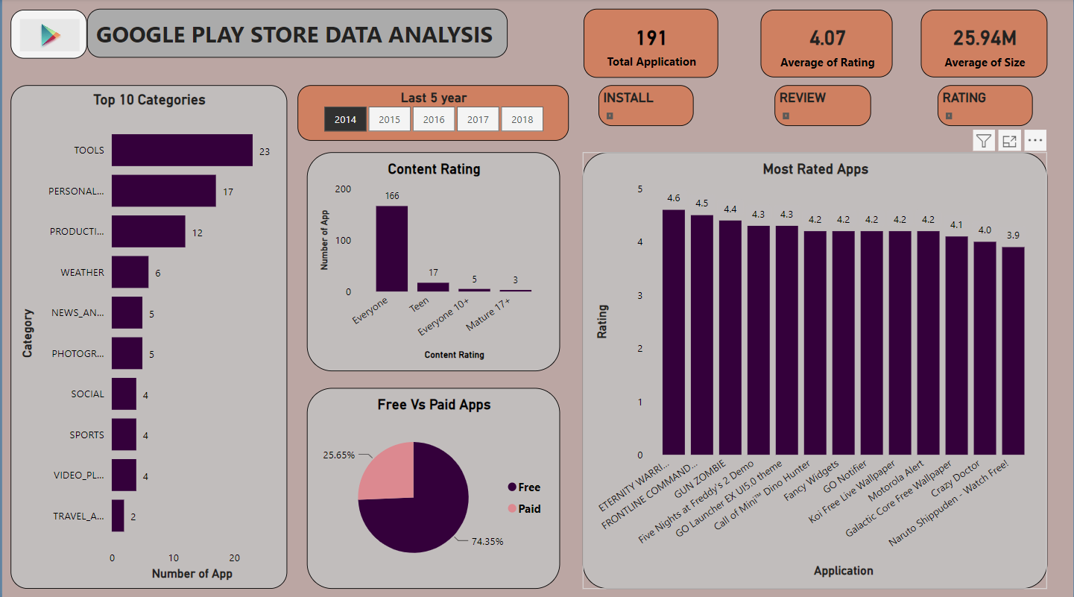

Slide 10
Conclusion:
The Google Play Store data analysis project provides valuable insights into app performance, user behavior, and revenue generation. The findings and recommendations can guide app developers and stakeholders in making informed decisions to optimize their apps' performance and enhance user satisfaction. The project demonstrates the power of data analysis in unlocking meaningful insights and driving

